Slide 1
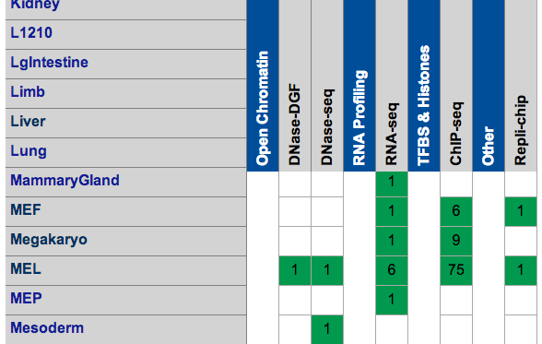
Mouse ENCODE
 | RNA | H3k4me1 | H3k4me3 | H3k27ac | H3k27me3 | CTCF | Polr2a
Cerebellum | UCSD-REN Adult 8 weeks
ES-Bruce4 | UCSD-REN Embryonic day 0
Heart | UCSD-REN Adult 8 weeks
Kidney | UCSD-REN Adult 8 weeks
Liver | UCSD-REN Adult 8 weeks
MEL | UCSD-REN
Intestine | UCSD-REN Adult 8 weeks
Spleen | UCSD-REN Adult 8 weeks
Testis | UCSD-REN Adult 8 weeks
Thymus | UCSD-REN Adult 8 weeks
Brain | UCSD-REN Embryonic day 14.5

Slide 2
Hypothesis
M1
M2
GENE
0 0 0 1 1 1 1 1 0 1 0
Samples: Cerebellum, ES-Bruce4, Heart, Kidney, Liver, MEL, Intestine, Spleen, Testis, Thymus, Brain
Histone marks: H3k4me1, H3k4me3, H3k27ac, H3k27me3
Transcription factors: CTCF, Polr2a
Gene expression: 4000 selected based on expression and variation

Slide 3
Epi-genome hotspots
S1
S2
.
.
.
S10
S11
0 1 0 0 0 1 0 0 0 0 1 1 1 1 1 0 1 0
1 0 0 0 0 1 0 0 0 0 0 0 0 0 0 0 0 0
…
0 1 1 0 0 1 0 0 1 0 0 0 0 1 1 0 0 1
0 1 0 0 0 1 0 0 0 0 0 0 1 0 0 0 0 1
1 1 1 0 0 1 0 0 1 0 1 1 1 1 1 0 0 1

Slide 5
Epi-genome hotspots
Mark 1
Mark 2
…
Mark 4

Slide 7
M
M
M
Promoter
EXON
EXON
Length of coverage
Number of peaks
Intensity of the peak
Signal of the peak
RNA abundance
Models:
Single correlation: Pearson’s and linear regression
Pair correlation: Each pair with interactive term
AIC auto selection
Samples: ESB4, MEL

Slide 8
A starting point for studying interaction?

Slide 9
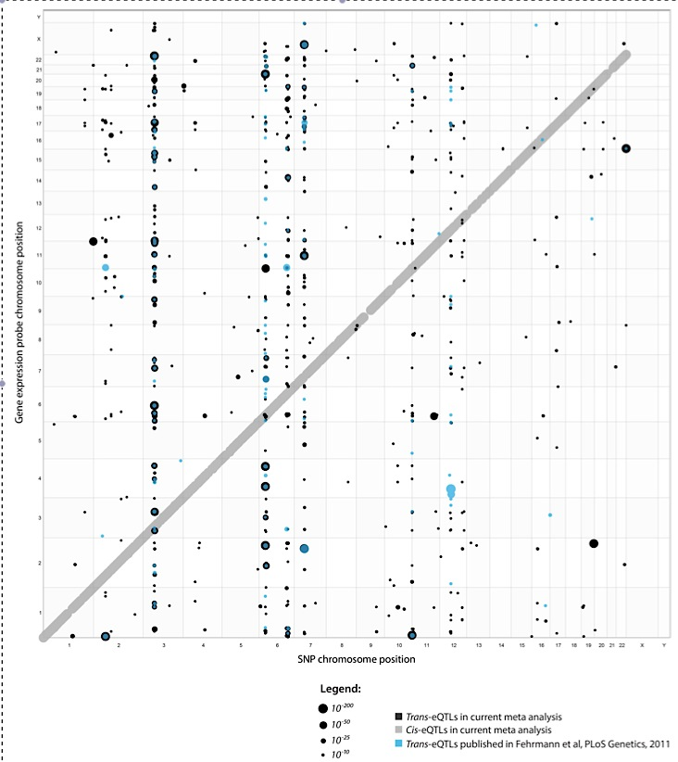
Positions of cis and trans-eQTLs
Systematic identification of trans eQTLs as putative drivers of known disease associations
2013 Nature Genetics

